Slide 1
Report
for May 2020 MP
BFX - AT100 (T99X171.00)
Date : 20 June 2020
Prepared by: Luu Mien

Slide 2
Issue Description
5 June 2020, ALT customer complain [BFX-AT100] May 2020 Mass production issue.
Defect Total:
1. No power on (Critical) : 1/500pcs (0.2%)
2. No HDMI Output (Critical) 1/500pcs (0.2%)
3. LED lens cosmetic defect (Minor) : 1/500pcs (0.2%)
4. Gift-box damaged (Minor) : 1/500pcs (0.2%)
5. HDMI cable no output to TV (Minor) : 2/500pcs (0.4%)
6. Ethernet cable NG (Minor) : 1/500pcs (0.2%)

Slide 3
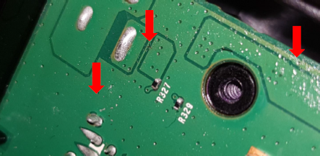
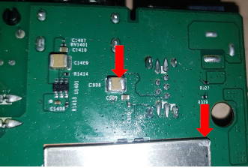
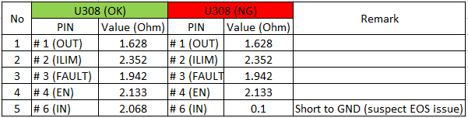
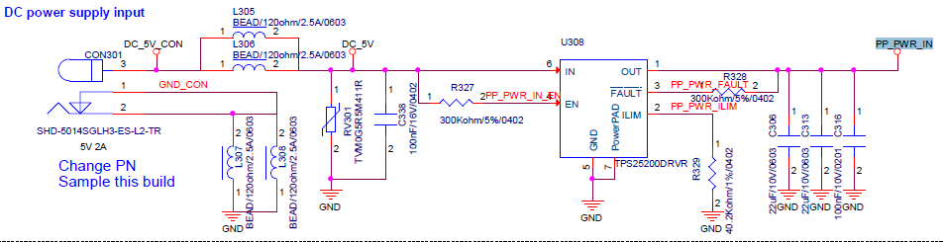

1. No power on
Issue Description | Root Cause | Actions | Owner | Due Date | Status
Phenomenon: No power on Type: Critical Q’ty : 1/500pcs DR: 0.2% | VI and found out solder splashes on PCBA (pictures below) ➔ May be in touching up process at PTH, operator did not operate carefully lead to this phenomenon. PTH VI also did not check carefully lead to escaped the defect. 2. X-Ray inspection: no issue found. 3. Checked the power: P5V, P3V3, P1V8, P1V8_EMMC, P1V2, P2V5, VDDCPU and VDDEE --> found out PP_PWR_IN no output. Checked console information --> no issue found. Suspect U308 (IC SW 2.5~6.5V SMD WSON6 GP TPS25200) component issue. | Showed a quality alert for solder splashes on PCBA issue and re-trained PTH operator need check carefully to avoid defect escape. Used a multi-meter to check internal impedance of U308 component found out the U308_PIN6 (IN) short to GND, result as below: Changed new U308 component then pass. Suspect EOS issue make U308 damaged 3. Every shift TE Engineer to check ESD status of all power cable, HDMI cable for test station. 4. Add ion fan on the assembly station and PCBA testing station to preventive ESD issue during processing. Please see below attached file for detail report: | PQE-Mien PE-Frank TE- Thiep | 10 Jun 20 20 Jun 20 20 Jun 20

Slide 4
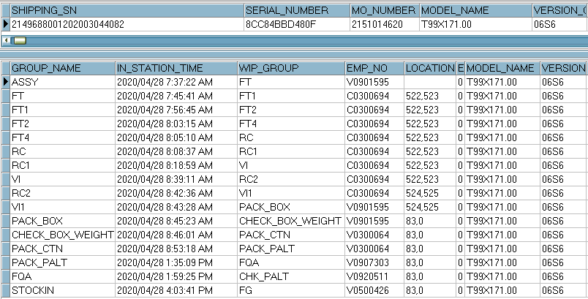
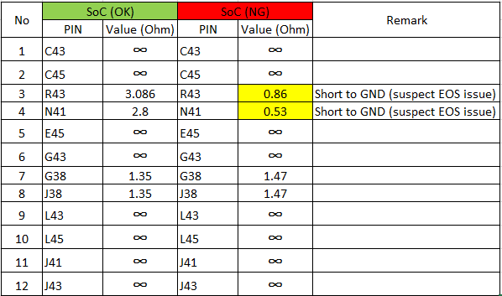

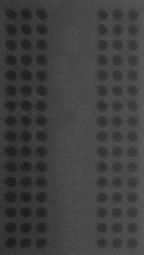
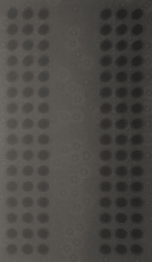
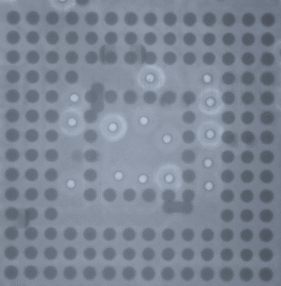

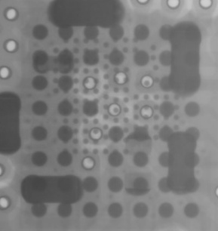

2. No HDMI output
Issue Description | Root Cause | Actions | Owner | Due Date | Status
Phenomenon: No HDMI output. Type: Critical Q’ty : 1/500pcs DR: 0.2% | Checked history. This unit was passed all stations smoothly. Visual inspection and X-Ray inspection no issue found. 3. OTT boot up normal but not HDMI signal out. 4. Checked the power: P5V, P3V3, P1V8, P1V8_EMMC, P1V2, P2V5,VDDCPU and VDDEE are system clock no issue found. 5. Checked console information --> no issue found Suspect Soc component issue. | Used a multi-meter to check impedance of Soc component for all HDMI PIN -> found out U1_PIN R43 (HDMI_SDA) and U1_PIN N41 (HDMI_SCL) short to GND, result as below: 2. Changed new Soc component and eMMC then pass. Suspect EOS issue make SOC damaged 3. Every shift TE Engineer to check ESD status of all power cable, HDMI cable for test station. 4. Add ion fan on the assembly station and PCBA testing station to preventive ESD issue during processing. Please see below attached file for detail report: | PE-Frank PE-Frank TE-Thiep | 20 Jun 20 20 Jun 20 20 Jun 20
Soc
DDR
EMMC
FIL1401 FIL1402
U1001

Slide 5
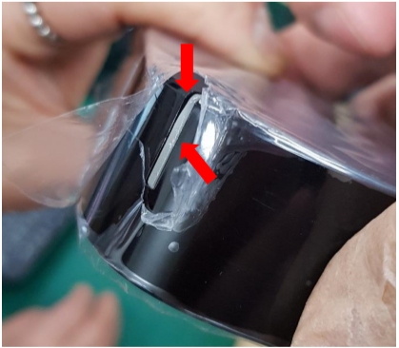





3. Led Lens cosmetic defect
Issue Description | Root Cause | Actions | Owner | Due Date | Status
Phenomenon: Led lens cosmetic defect Type: Minor Q’ty : 1/500pcs DR: 0.2% | Vendor root cause: This issue is from incoming material issue. The defect of the light pipe is Short shot, which is a common phenomenon of the shaping adjuster, and can be improved by adjusting the molding parameters. This defective product should be produced in the process of adjusting the machine. It is mixed into the normal product due to not being cleaned in time. QC failed to detect it during sampling inspection. Escaped cause (at FXN): Top case was covered by a protective film. Operator at Assembly station did not check carefully before assembling housing. Operator at VI station also did not check visual carefully lead to escaped. | FXN SQE was responsible for inform and send the defect to vendor for further analysis and give out vendor’s action: - The products produced during the adjustment shall be separately labeled and placed. After the adjustment is OK, it shall be scrapped. - After handling the machine abnormalities, the first 5 mold products are directly isolated and discarded. - QC to confirm OK before starting production Please refer to below attached file for vendor’s report. FXN action: - Showed and re-trained operator at assembly and VI station for checking requirement. Line leader often check and monitor all operators at all stations to make sure their operating comply with SOP. IPQC keep sample check and audit daily in production line. (IPQC depend on Assembly and VI SOP and Quality Alert to sample check) | SQE-Mai PQE-Mien PD-Loi IPQC-Tam | 23 Jun 20 10 Jun 20 10 Jun 20 20 Jun 20

Slide 6


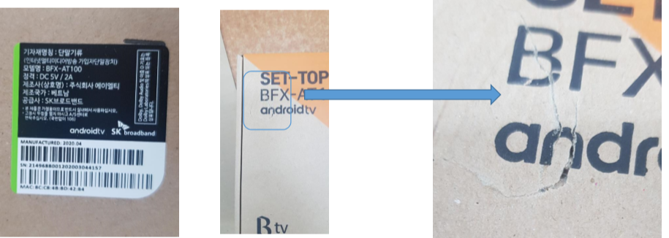
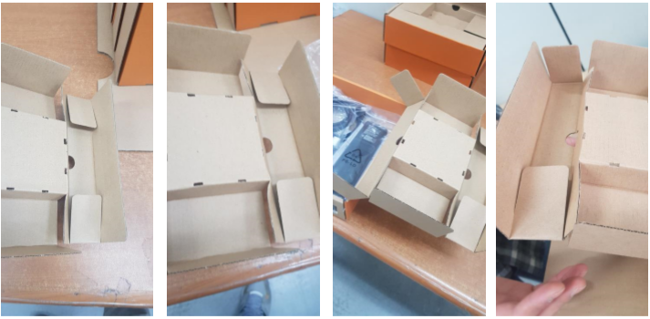
4. Gift-box damaged
Issue Description | Root Cause | Actions | Owner | Due Date | Status
Phenomenon: Gift-box damaged Type: Minor Q’ty : 1/500pcs DR: 0.2% | Operator at Packing carton station did not operate carefully during taking box from production line to carton lead to touch with strong force to nearly printer caused this defect. He put this box to carton directly and not check again lead to escape. | Showed and re-trained operator at pack box and Pack Carton station for checking requirement. Line leader often check and monitor all operators at all stations to make sure their operating comply with SOP. IPQC keep sample check and audit daily in production line. (IPQC depend on Pack box and Pack carton SOP and Quality Alert to sample check) | PQE-Mien PD-Loi IPQC-Tam | 10 Jun 20 10 Jun 20 10 Jun 20
Gift-box be damaged
Poor box folding method

Slide 7
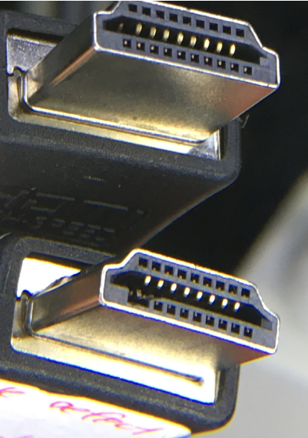
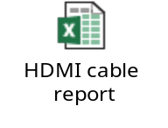
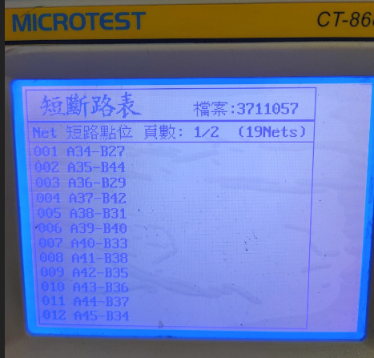
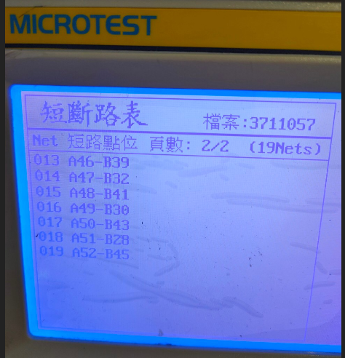
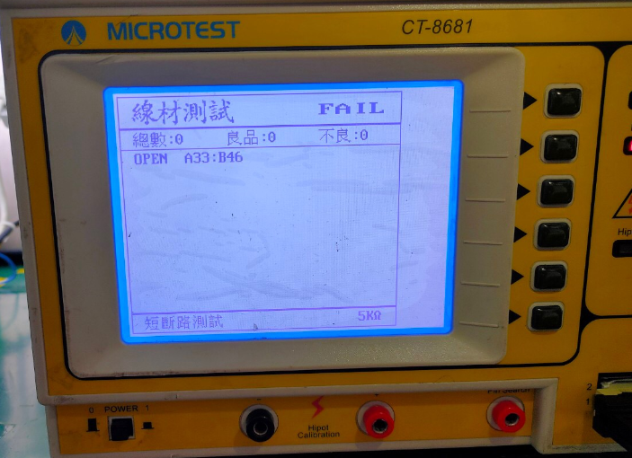
5. HDMI cable no output to TV
Issue Description | Root Cause | Actions | Owner | Due Date | Status
Phenomenon: HDMI cable no output to TV. Type: Minor Q’ty : 2/500pcs DR: 0.4% | FXC rechecked and confirmed the defect: HDMI cable no output (# 1): Visual inspection and X-Ray inspection no issue found. Use a Microtest CT - 8681 machine to check fount out it unstable (2 times fail and 1 times pass) Plug HDMI cable on the OTT and TV (HDMI 2K and 4K ), it show unstable. HDMI cable no output (# 2): Visual inspection and X-Ray inspection fund out HDMI PIN # 17 & 19 damaged and PIN # 18 bent PIN. Use a Micotest CT - 8681 machine to check fount out HDMI cable PIN #18 open issue. This issue was from incoming material issue. | IQC tighten inspection from AQL 0.4 to AQL 0.25 SQE is responsible for inform and send the defect to vendor (18.June.2020) for further analysis and give out report of root cause and corrective action. (due date: 3 days after vendor receiving defects) | SQE-Mai | 3 Jul 20
HDMI PIN # 17 & 19 damaged and PIN # 18 bent PIN

Slide 8
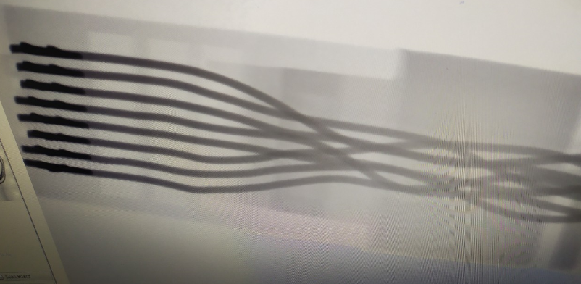
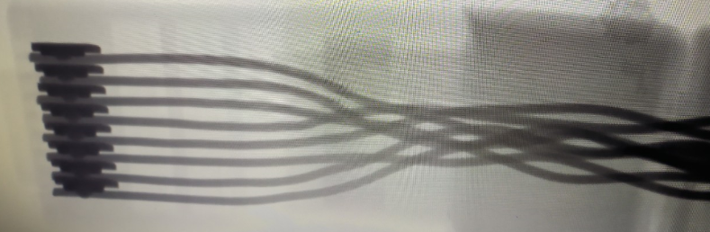
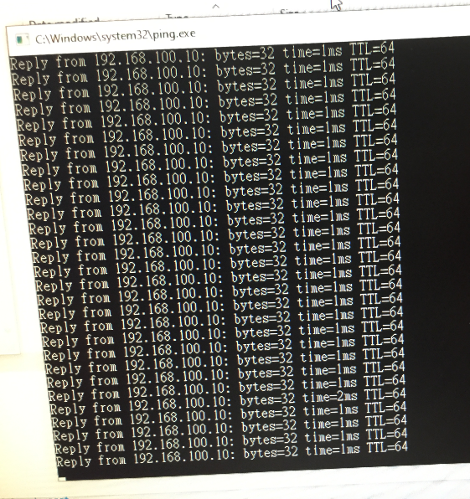

6. Ethernet cable NG
Issue Description | Root Cause | Actions | Owner | Due Date | Status
Phenomenon: Ethernet cable NG. Type: Minor Q’ty : 1/500pcs DR: 0.2% | FXC rechecked and confirmed the defect: Visual inspection and X-Ray inspection no issue found. Use a multi-meter to check impedance and connection no issue found Plug Ethernet cable on the OTT and Computer, it show normally (Ping OTT connection to Computer normally) NTF (Not True Fail) | IQC tighten inspection from AQL 0.4 to AQL 0.25 SQE is responsible for inform and send the defect to vendor (18.June.2020) for further analysis and give out report of root cause and corrective action. (due date: 3 days after vendor receiving defects) | SQE-Mai | 3 Jul 20

